Slide 1
Sectors and Industries of Bangladesh
By
Chowdhury Mujaddid Ahmed

Slide 2
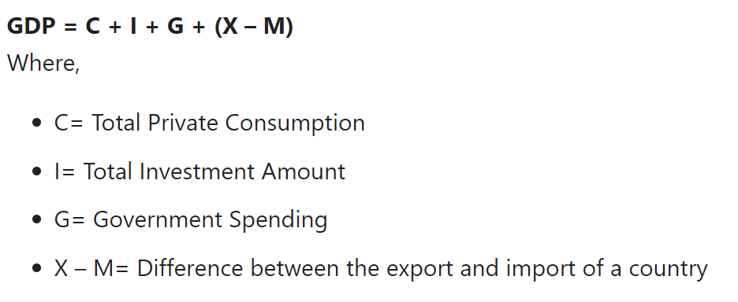
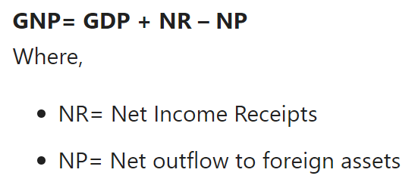
GDP vs GNP

Slide 3
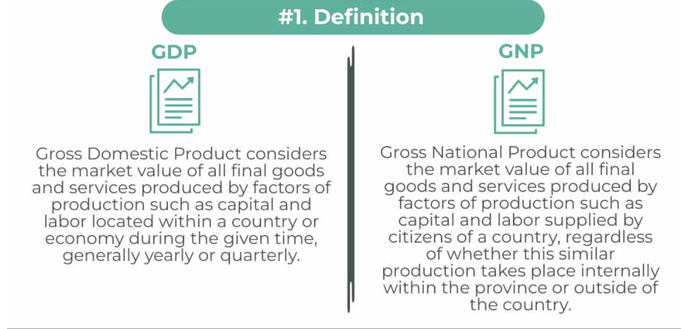
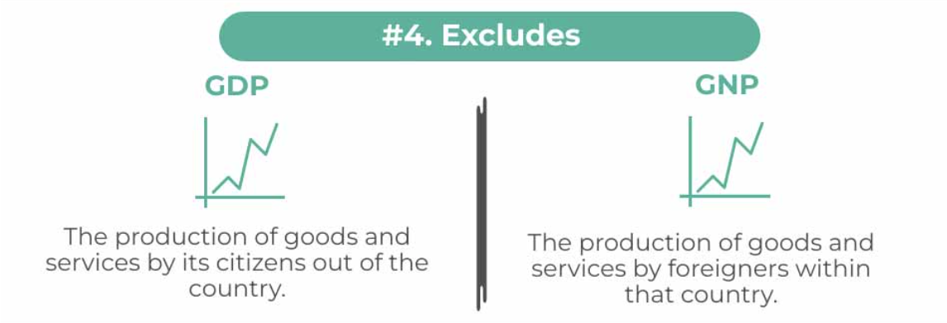
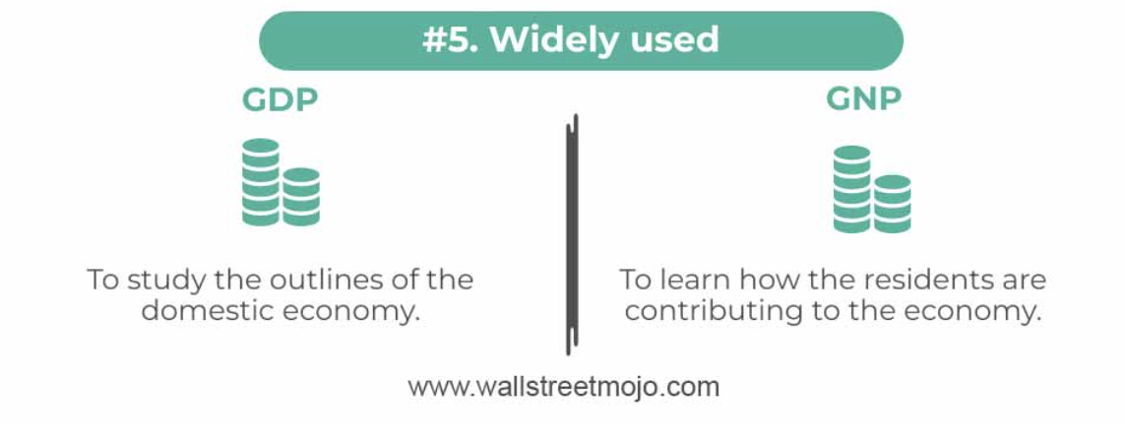
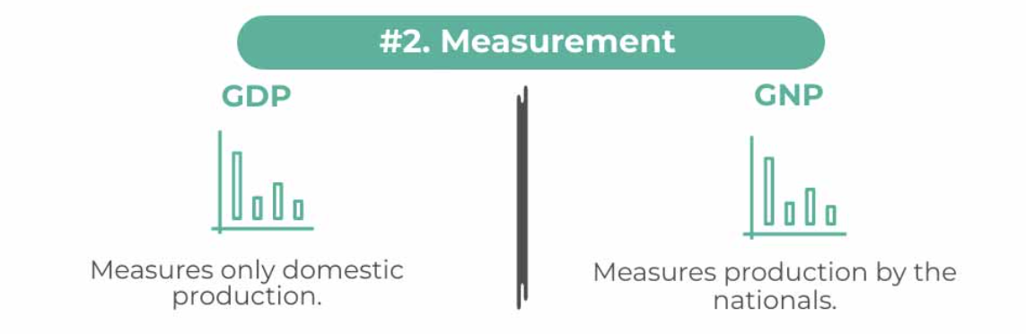
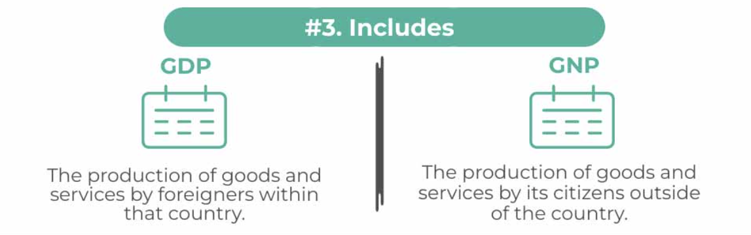
Source: GDP vs GNP (wallstreetmojo.com)

Slide 4
What is a sector?
A sector refers to a broad economic segment that contains industries while an industry falls within a sector and breaks down according to more specific companies and business activities.
Although some may think of them as the same, the terms "industry" and "sector" have different meanings. Industry refers to a specific group of similar types of companies, while sector describes a large segment of the economy. In the stock market, the generally accepted terminology cites a sector as a broad classification and an industry as a more narrow one.

Slide 5
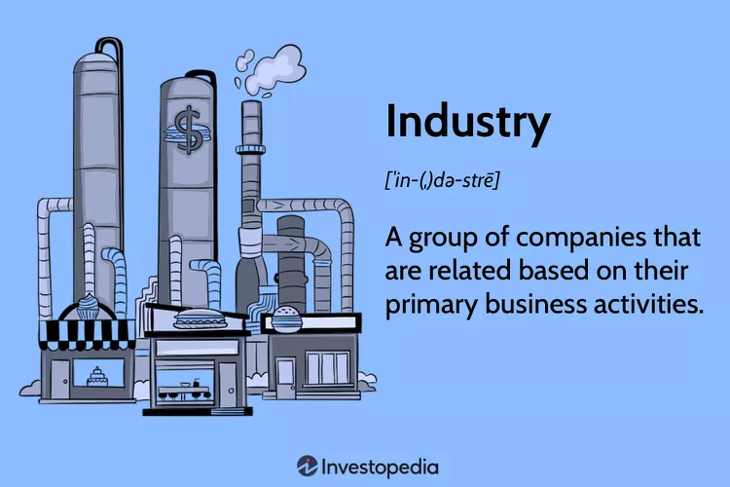
What is an industry?
Individual companies are generally classified into an industry based on their largest sources of revenue. For example, while an automobile manufacturer might have a financing division that contributes 10% to the firm's overall revenues, the company would be classified in the automaker industry by most classification systems.

Slide 6
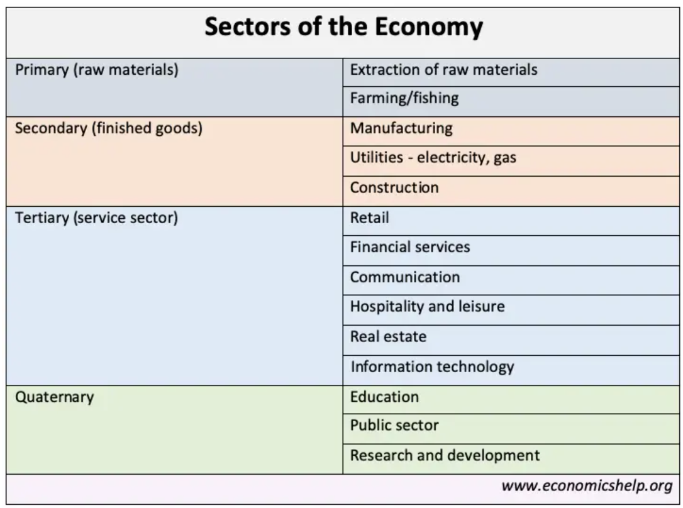
Economic Sectors

Slide 7
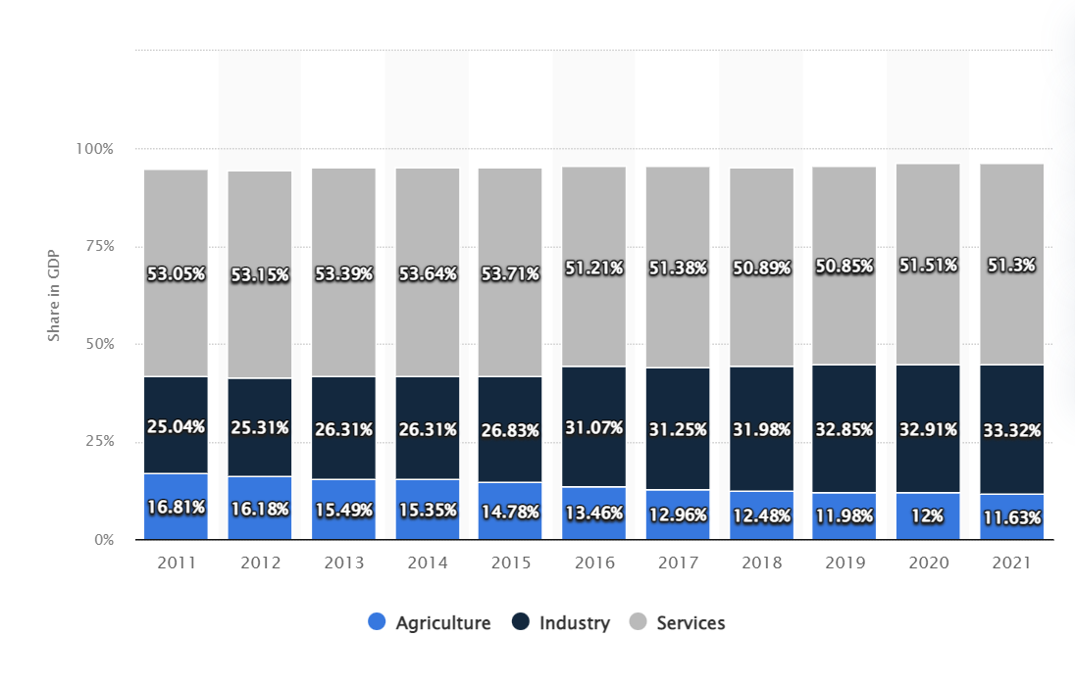
Economic sectors of Bangladesh
Statista.com

Slide 8

Major Industries of Bangladesh
RMG and Textile Industry
Agriculture
Leather Industry
Fisheries
Pharmaceuticals
Software Service Industry

Slide 9
RMG and the Textile Industry
Accounts for more than 80.6% of total exports contributing to $19.90 billion.
Bangladesh is the second largest RMG exporter. According to the Export Promotion Bureau (EPB), Bangladesh’s export of garments increased by 30.30% to $23.99 billion between July 2021 and January 2022.
China is the country that exports the most garments worldwide. And Bangladesh still continues to maintain its second position in RMG export.
The country exports a large variety of clothing items to nations in many different geographical areas, including North America, Europe, Asia, and others.
Woven and knitwear are the two main categories into which export goods may often be divided.
Exports of knitwear increased by 32.89 % to $13.27 billion. And the export of woven clothing increased by 27.23% to $10.71 billion.

Slide 10
Agriculture
Agriculture supported and contributed to the people and state of Bangladesh throughout the entirety of the COVID-19 pandemic.
Agriculture is the primary source of livelihood to 40% of the labor force, it is the largest sector in terms of employment.
And Bangladesh’s earnings from exporting agricultural products reached the $1 billion mark for the first time during this period.
Crops and horticulture, animal farming, forest, and other related industries all have increased in FY 2020–21 amounting to 1.59%, 3.80%, and 6.12%, respectively.
The supply of basic raw materials for industrial processing is also an indirect contribution from Bangladesh’s agriculture industry. (sugar, tea, jute, fruit juice, or processed spices, rely entirely on agriculture for their fundamental raw materials.)

Slide 11
Leather Industry
Bangladesh is seeing a steady upward trend in the export of leather and leather goods.
The government’s projected aim is to increase exports of leather goods by establishing a goal of earning $10-12 billion between 2021 and 2030.
Total export revenue in FY 2021 was $941.67 million, as opposed to $563.96 million in the first half of the current fiscal year.
According to the ministry and sectoral entrepreneurs, leather and leather goods makeup 4% and 0.5% of Bangladesh’s total exports, respectively.
About 12.5%, 27%, and 60% of the sector’s total exports for fiscal 2020–21 were made up of leather, leather goods, and leather footwear.
In the first quarter of the current fiscal year, Bangladesh’s exports of leather and leather goods increased from pre-pandemic levels.
According to EPB data, leather exports increased by 33.29% in the first quarter of FY 2022, leather products by 33.34%, and leather footwear by 13.72%.

Slide 12
Fisheries
Fish and fisheries are an essential aspect of Bangladesh. In the last 20 years, Bangladesh’s fish production has expanded substantially by over 400%.
According to the fisheries department, the fishing industry provides more than one-fourth (26.37%) of the country’s agricultural GDP and 3.52% of the nation’s overall GDP, making it an important sector for the socioeconomic growth of the nation.
Moreover, the fishing sector accounts for 1.39% of the total national exports.
During the fiscal year 2019–20, the nation produced around 4.503 million tonnes of fish.
The country’s export of shrimp has especially seen a significant increase during the past six months, from July to December 2021.

Slide 13
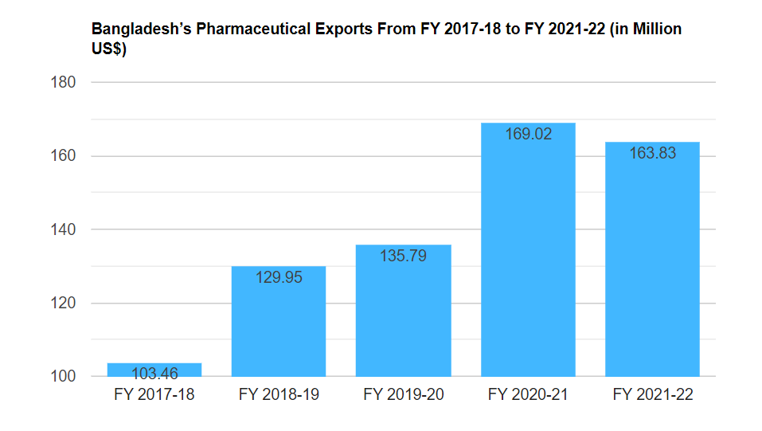
Pharmaceuticals
The most advanced, high-tech industries contributing to Bangladesh’s economy.
By 2025, it’s anticipated that Bangladesh’s pharmaceutical business would be worth more than $6 billion.
Bangladesh has exported 2,000 different pharmaceutical product categories to more than 150 nations.
The pharmaceutical industry, which covers 97% of local demand, has grown at a compound annual growth rate (CAGR) of 12.1% over the previous five years.
This shows that pharmaceutical export increased by 27% in the current fiscal year. USA, UK, Europe, and Australia are just a few of the developed markets where Bangladeshi drugs have already made their way.

Slide 14
Software Service Industry
South Asia’s fastest expanding hubs for software exports and IT outsourcing.
The ICT industry has consistently added to the nation’s GDP, which has led to the economy’s constant growth.
The sector generated $1.3 billion in export revenue in FY 2020–21, holding a $1.4 billion market share in local market sales.
More than one million job opportunities have been created in Bangladesh by the IT/ITES sector, contributing 0.76% to the country’s overall GDP.

Slide 15
Banking Industry
Banks After the independence, the banking industry in Bangladesh started its journey with 6 Nationalized commercialized banks, 3 State owned Specialized banks, and 9 Foreign Banks. In the 1980s banking industry achieved significant expansion with the entrance of private banks. Now,
banks in Bangladesh are primarily of two types:
Scheduled Banks: The banks that remain in the list of banks maintained under the Bangladesh Bank Order, 1972.
Non-Scheduled Banks: The banks which are established for special and definite objective and operate under any act but are not Scheduled Banks. These banks cannot perform all functions of scheduled banks.

Slide 16
Financial Institutions
Non Bank Financial Institutions (FIs) are those types of financial institutions which are regulated under Financial Institution Act, 1993 and controlled by Bangladesh Bank. Now, 35 FIs are operating in Bangladesh while the maiden one was established in 1981. Out of the total, 2 is fully government owned, 1 is the subsidiary of a SOCB, 19 were initiated by private domestic initiative and 13 were initiated by joint venture initiative. Major sources of funds of FIs are Term Deposit (at least three months tenure), Credit Facility from Banks and other FIs, Call Money as well as Bond and Securitization.
The major difference between banks and FIs are as follows:
FIs cannot issue cheques, pay-orders or demand drafts.
FIs cannot receive demand deposits,
FIs cannot be involved in foreign exchange financing,
FIs can conduct their business operations with diversified financing modes like syndicated financing, bridge financing, lease financing, securitization instruments, private placement of equity etc.

Slide 17
Reference
Bangladesh Bank
Statista.com
Investopedia
Business Inspection

Slide 18
Thank you
End
of
Lecture 8

